Slide 1


Mass Fit results and btagging efficiency
George Bakas, Ioannis Papakrivopoulos

Slide 2
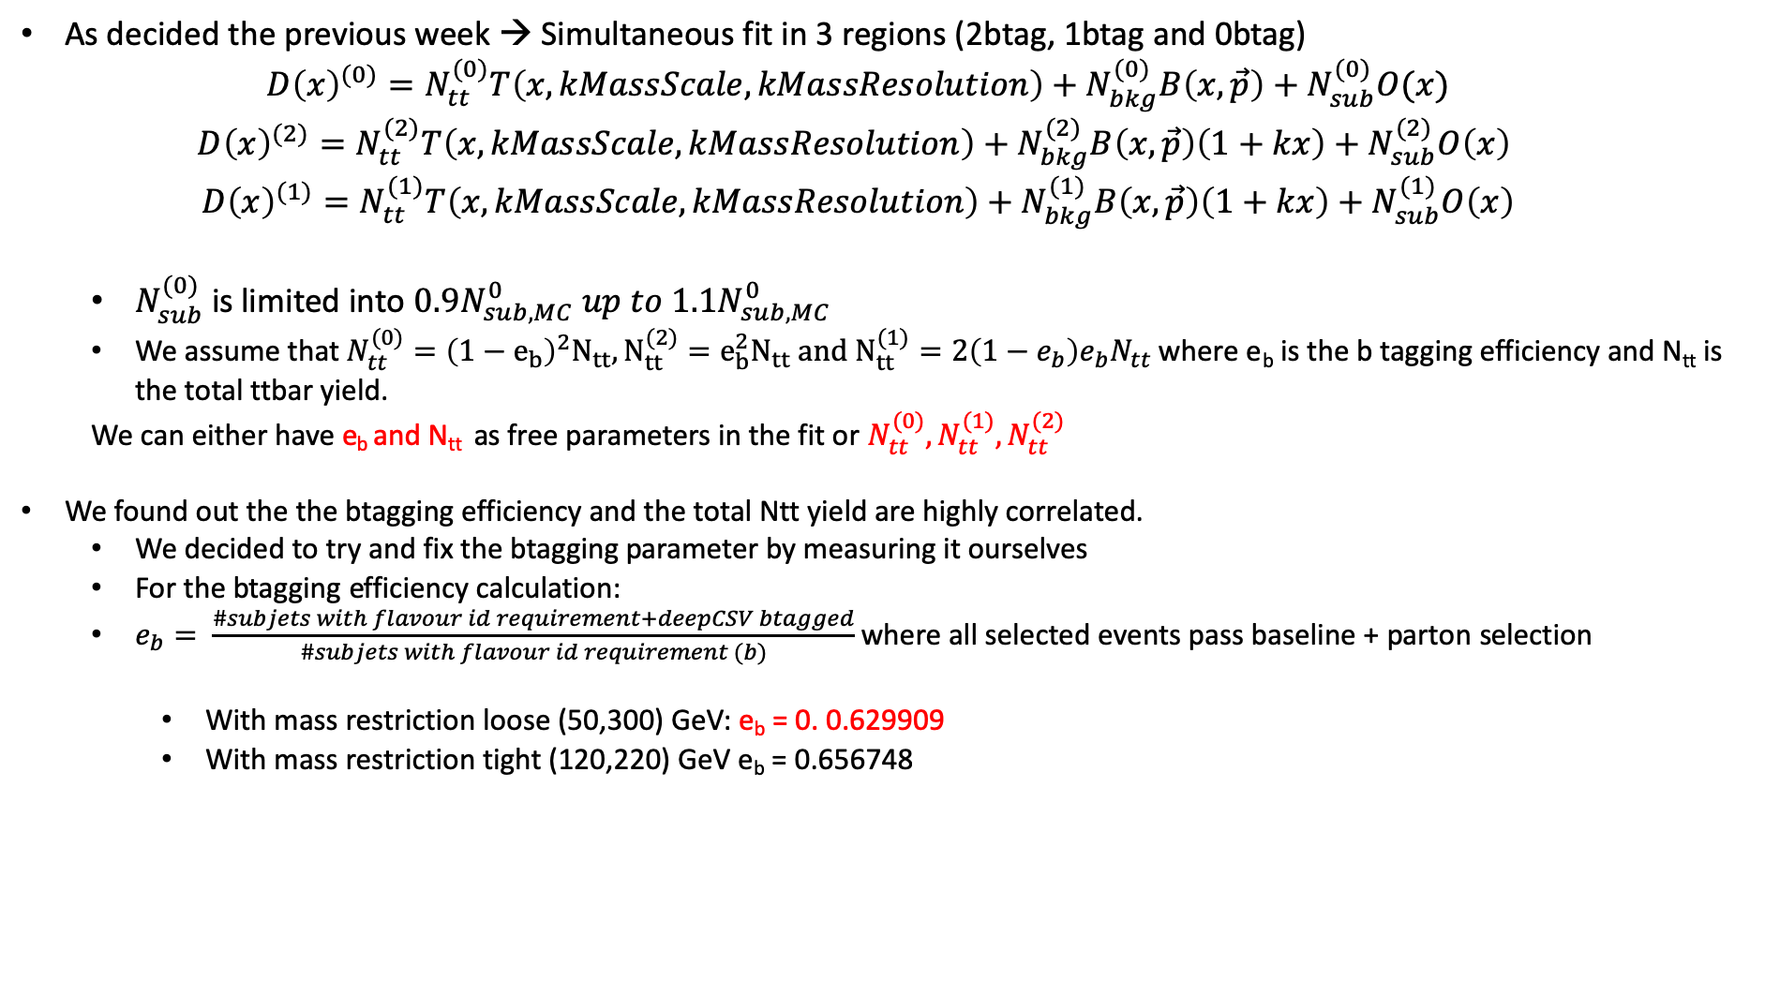
Simultaneous Fit in 3 regions
As decided the previous week → Simultaneous fit in 3 regions (2btag, 1btag and 0btag)
$$D{\left(x\right)}^{(0)}=N_{tt}^{(0)}T\left(x, kMassScale, kMassResolution\right)+N_{bkg}^{(0)}B\left(x,\vec{p}\right)+N_{sub}^{(0)}O(x)$$
$$D{\left(x\right)}^{(2)}=N_{tt}^{(2)}T\left(x,kMassScale, kMassResolution\right)+N_{bkg}^{(2)}B\left(x,\vec{p}\right)\left(1+kx\right)+N_{sub}^{(2)}O\left(x\right)$$
$$D{\left(x\right)}^{(1)}=N_{tt}^{(1)}T\left(x,kMassScale, kMassResolution\right)+N_{bkg}^{(1)}B\left(x,\vec{p}\right)\left(1+kx\right)+N_{sub}^{(1)}O\left(x\right)$$
$N_{sub}^{(0)}$ is limited into $0.9N_{sub,MC}^{0} up to 1.1N_{sub,MC}^{0}$
We assume that $N_{tt}^{(0)}={\left(1−e_{b}\right)}^{2}N_{tt}, N_{tt}^{(2)}=e_{b}^{2}N_{tt} and N_{tt}^{(1)}=2\left(1−e_{b}\right)e_{b}N_{tt}$ where e_{b} is the b tagging efficiency and N_{tt} is the total ttbar yield.
We can either have e_{b} and N_{tt} as free parameters in the fit or $N_{tt}^{(0)},N_{tt}^{(1)},N_{tt}^{(2)}$
We found out the the btagging efficiency and the total Ntt yield are highly correlated.
We decided to try and fix the btagging parameter by measuring it ourselves
For the btagging efficiency calculation:
$e_{b}= \frac{\#subjets with flavour id requirement+deepCSV btagged}{\#subjets with flavour id requirement (b)}$ where all selected events pass baseline + parton selection
With mass restriction loose (50,300) GeV: e_{b} = 0. 0.629909
With mass restriction tight (120,220) GeV e_{b} = 0.656748

Slide 3
Overview
Extension of Signal Region → SR_{A} = SR – Mass Selection cuts
Selection:
Jet Matching
Parton cuts:
partonPt[0],[1] > 400
|partonEta[0],[1]| < 2.4
mTTbarParton > 1000
Reco cuts:
nJets > 1
nLeptons = 0
mJJ > 1000
jetPt[0],[1] > 400
|jetEta[0],[1]| < 2.4
bTagging cut (mediugm WP deepCSV) (2016: 0.6321, 2017: 0.4941, 2018: 0.4184)
Tagger cut (top Tagger) (2016: 0.2, 2017:0.0, 2018: 0.1)
TriggerBit

Slide 4
Purpose of this presentation
Show the fit result in two ways:
Fix the e_{b} parameter at a certain value → This will be Method A
Let the e_{b} parameter run on a very tight interval [0.5,0.8] → This will be Method B
Results:
Method A: r = 0.85347 with Ntt expected = 16351 and Ntt observed = 13955
Method B: r = 1.02045 with Ntt expected = 16351 and Ntt observed = 16686
Floating Parameter FinalValue +/- Error
-------------------- --------------------------
btagEff 5.6029e-01 +/- 1.17e-02
kMassResol 9.6557e-01 +/- 2.29e-02
kMassScale 1.0020e+00 +/- 1.60e-03
kQCD_1b 5.8296e-03 +/- 4.50e-04
kQCD_2b 7.7313e-02 +/- 4.98e-02
nFitBkg_0b 4.5269e+03 +/- 5.63e+01
nFitBkg_1b 2.3159e+03 +/- 4.02e+02
nFitBkg_2b 2.3726e+02 +/- 4.25e+01
nFitQCD_0b 8.7019e+04 +/- 4.15e+02
nFitQCD_1b 2.8973e+04 +/- 3.93e+02
nFitQCD_2b 2.9980e+03 +/- 1.43e+02
nFitSig 1.6686e+04 +/- 6.56e+02
Floating Parameter FinalValue +/- Error
-------------------- --------------------------
kMassResol 9.2150e-01 +/- 2.07e-02
kMassScale 1.0023e+00 +/- 1.60e-03
kQCD_1b 6.3680e-03 +/- 4.58e-04
kQCD_2b 5.9385e-02 +/- 3.48e-02
nFitBkg_0b 4.5269e+03 +/- 4.25e+01
nFitBkg_1b 2.3356e+03 +/- 2.73e+02
nFitBkg_2b 2.0703e+02 +/- 2.32e+01
nFitQCD_0b 8.8323e+04 +/- 3.13e+02
nFitQCD_1b 3.0542e+04 +/- 2.62e+02
nFitQCD_2b 2.8400e+03 +/- 1.55e+02
nFitSig 1.3955e+04 +/- 3.69e+02

Slide 5
Simultaneous Fit in 3 regions Method A
Signal Region (2btag)
Control Region (0btag)

Slide 6
Simultaneous Fit in 3 regions Method B
Signal Region (2btag)
Control Region (0btag)

Slide 7
Simultaneous Fit in 3 regions (1btag Region)
Method A
Method B

Slide 8
b-tagging
Efficiency

Slide 9
b-tagging Purity

